Slide 1
Annual meeting 2019
June 14, 2019

Slide 2
Meeting Agenda
Call Meeting to Order – Matt Omundson, UCPID Board President
Secretary Report – Larry Walton, UCPID Board Secretary & Treasurer
Treasurer Report
President Report
GlenStar Properties – Renovations Update
Executive Director’s Report – Patrick Sanders, UCPID Executive Director
Adjourn

Slide 3
UCPID Board
Matt Omundson– GlenStar Properties
Brad Cheves – SMU
Larry Walton – The Highland Residences
Paul Ward – SMU
Margaret DiFrancesco – Public Service Plumbers
Andrea Sanders – Oncor
Brent Halvorson – Shelby Residences
Matt McGeath – GlenStar Properties
Lawrence Ward - Oncor
Julia Hart – GlenStar Properties
James Montgomery – Magnolia Hotel
Erin McKool – Start Restaurant
Kristin Munson- The Highland Residences

Slide 4
2018 - 2019 highlights

Slide 5
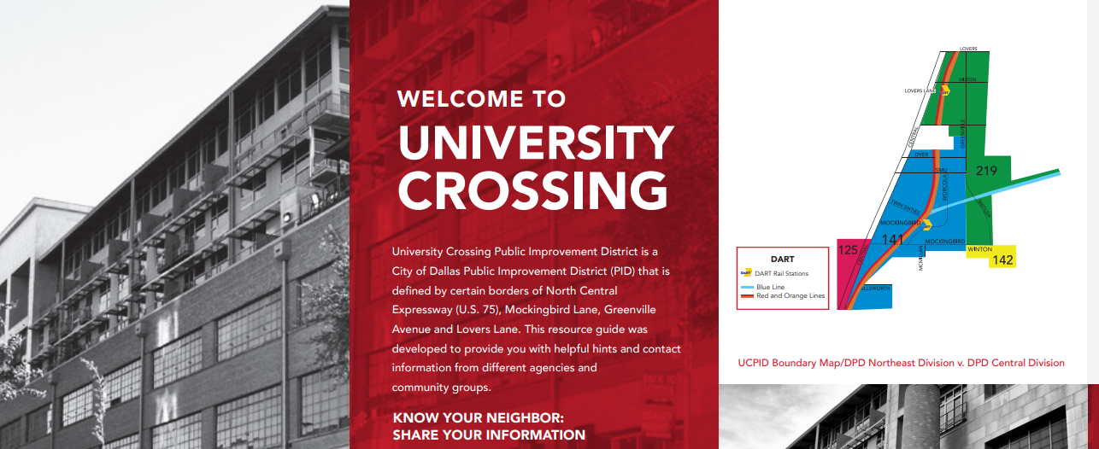
Highlights from 2018-2019
PUBLIC SAFETY Programs:
Community success with Expanded Neighborhood Patrol Program (ENP)
Conducting more Lunch & Learn w/ ENP Educational Programs
Developing 2019-2020 University Crossing Resource Guide

Slide 6
Highlights from 2018-2019
CAPITAL IMPROVEMENT PROJECTS:
Obtained Official Name Change of the Pedestrian Trail to University Crossing Trail– Previously the Ridgewood Trail
Completed the Design Plan for Pedestrian Lighting along the University Crossing Trail
Continued University Crossing Bike Share (5 locations)
Funding a Public Mural in Glencoe Park
Developed Way-Finder Signs for the University Crossing Trail

Slide 7
Highlights from 2018-2019
CAPITAL IMPROVEMENT PROJECTS (Continued):
Facilitated & Partially Funded installation of Radar Feedback Sign (Premier Place)
Repainting Pedestrian Crosswalks (Strategic Locations)
Installed trash receptacles along SMU Blvd.
Advocated for Implementation of the Mockingbird Pedestrian & Bicycle Study
Developed Relocation Plan for “Split Atom” Sculpture along University Crossing Trail (Donated by GlenStar Properties)
Developed plan for “Pocket Park” across from the “Split Atom” Sculpture”

Slide 8
Highlights from 2018-2019
MAINTENANCE PROGRAMS:
Continued maintenance along:
Mockingbird Ln.
SMU Blvd.
The University Crossing Trail
Conducted Community Advocacy – Resulting in Cleaner Properties
Supported clean-up of St. Patrick’s Day Parade and other Strategic Programs

Slide 9
Highlights from 2018-2019
COMMUNICATION AND CULTURAL PROGRAMS:
Maintain www.universitycrossing.com
Continued Music on Mockingbird - live musical performances supported with collaboration from the UCPID, SMU Meadows School of the Arts and Mockingbird Station
Continued Bach in the Subways- UCPID partnered with DART, 101.1FM, SMU, and Mockingbird Station to host this first annual event
Update the University Crossing Resource Guide
Partnering with SMU to develop the University Crossing Culture-led Regeneration Project (UCCRP) along the University Crossing Trail

Slide 10
HIGHLIGHTS FROM 2018-2019
SERVICE PLAN (2019):
The University Crossing Public Improvement District (UCPID) Developed a Service Plan to support our many projects

Slide 11
2018 - 2019 public safety Programs

Slide 12
Expanded neighborhood patrol program
Expanded Neighborhood Patrol Program (ENP)– The UCPID Contracts with the Dallas Police Department (DPD) to hire off-duty Police Officers to Patrol our Community
Patrols occur Seven (7) Days a Week – With Extended Hours over the Weekend
These ENP Officers utilize a Proactive and Community-Based Policing model
The ENP Officers use community engagement tools such as the University Crossing Resource Guide to greet and engage with business owners and citizens
Next Steps: We hope the community will utilize this important program!!!

Slide 13
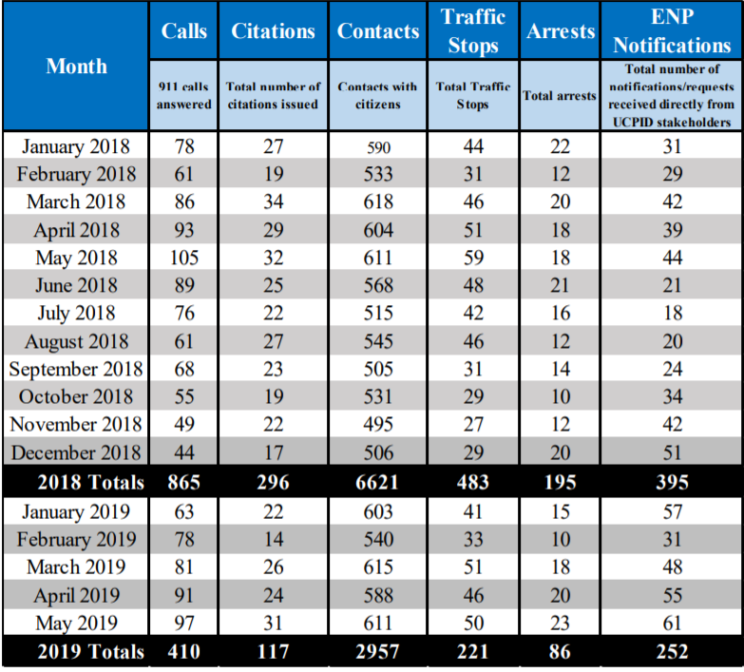
ENP Engagement Data (Jan. 2018-May 2019)

Slide 14
Lunch & learn educational program
The UCPID hosts Lunch & Learn programs upon request – The UCPID Executive Director and an ENP Officer will meet with a Community Stakeholder and/or their groups to discuss security “best practices”
The Lunch & Learn will focus on:
When to Call 911
Concerns about Homelessness; and
Situational Awareness; etc.
The ENP can also Facilitate Active Shooter Training
Schedule a lunch and learn today!
info@universitycrossing.com

Slide 15
2018 – 2019 Capital Improvement Projects

Slide 16
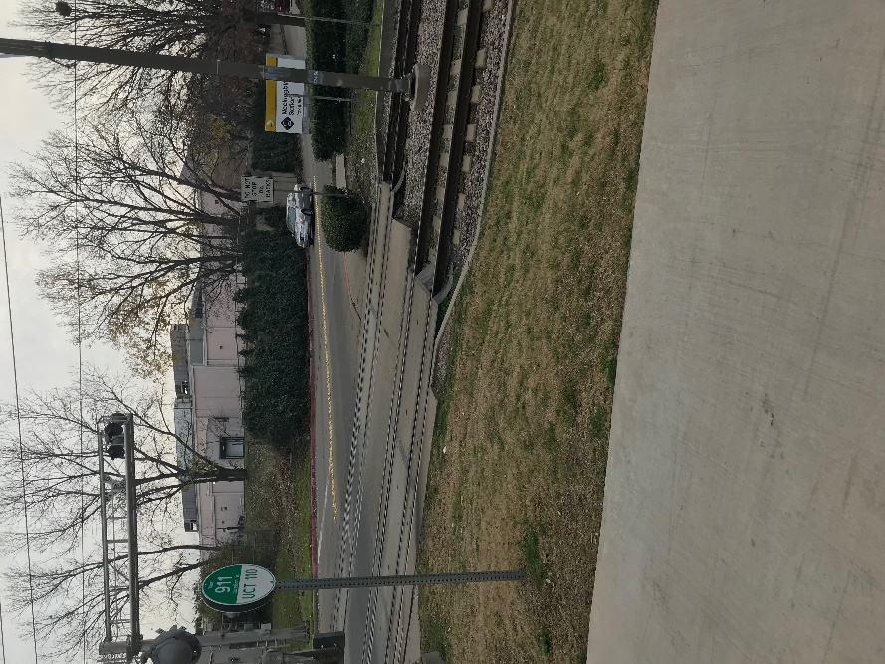
we are officially: the university crossing trail!!!
After Officially Requesting a Name Change for the Pedestrian Trail – The City of Dallas, Park & Recreations Dept. granted the UCPID’s Request
To memorialize the Name Change – The UCPID installed Trail Markers along the trail, which include the designator UCT
Next Steps: Enjoy the University Crossing Trail!!!

Slide 17
University Crossing trail (UCT) Map

Slide 18
Pedestrian lighting (along the university crossing trail)
In 2018 - The UCPID Commissioned Jacobs Consulting (Jacobs) to complete a Design Plan to install Pedestrian Lighting along the University Crossing Trail
In April 2019 – Jacobs Completed the Design Plan & Cost Estimate for the Project
The Design Plan calls for the following:
Light Fixtures from Glencoe Park (near Martel) to SMU Blvd.
Light Fixtures form the “Red Line” Bridge, above the DART line, heading east to the Greenville Ave. & Matilda Bridges
From Matilda Bridge to Skillman - Oncor will install light fixtures on the existing light poles
Estimated Cost - $950,000

Slide 19
the University Crossing TRAIL Pedestrian lighting project (Funding)
Now that the Design Plan & Cost Estimate are Complete – The UCPID will need to Fund the Project!
Background: In 2017 – The North Texas Council of Governments (NTCOG) awarded the UCPID a reimbursement grant to fund pedestrian lighting along the University Crossing Trail (Note: The UCPID will fully fund the project, but under the grant, the UCPID will receive an 80% reimbursement up to approximately $870,000).
Background: The UCPID is partnering with Dallas Park & Rec. to develop a Funding Agreement to install the pedestrian lighting
Background: In 2018 - The UCPID met with TXDOT, Park & Rec., and other Community Stakeholder to discuss implementation
Next Steps: In 2019 - The UCPID will execute a Funding Agreement with Park & Rec. which will enable us to begin installation of the lighting

Slide 20
Pedestrian lighting (proposed Area)

Slide 21
Pedestrian lighting (design plan)

Slide 22
University crossing (bike share)
In February 2019– with some modifications - The UCPID renewed the bike share program started by Mockingbird Station
This program is now fully funded by the UCPID and managed by Zagster
The program includes twenty (20) bikes and five (5) bike stations, located at:
The Highland Hotel;
Mockingbird Station;
6060 Building;
The Shelby Residences; and
The Meadows Building
Next Steps: Check out more information about renting a bike, including: a map of the stations and instructional video. Visit our landing page at: bike.zagster.com/mockingbirducpid

Slide 23
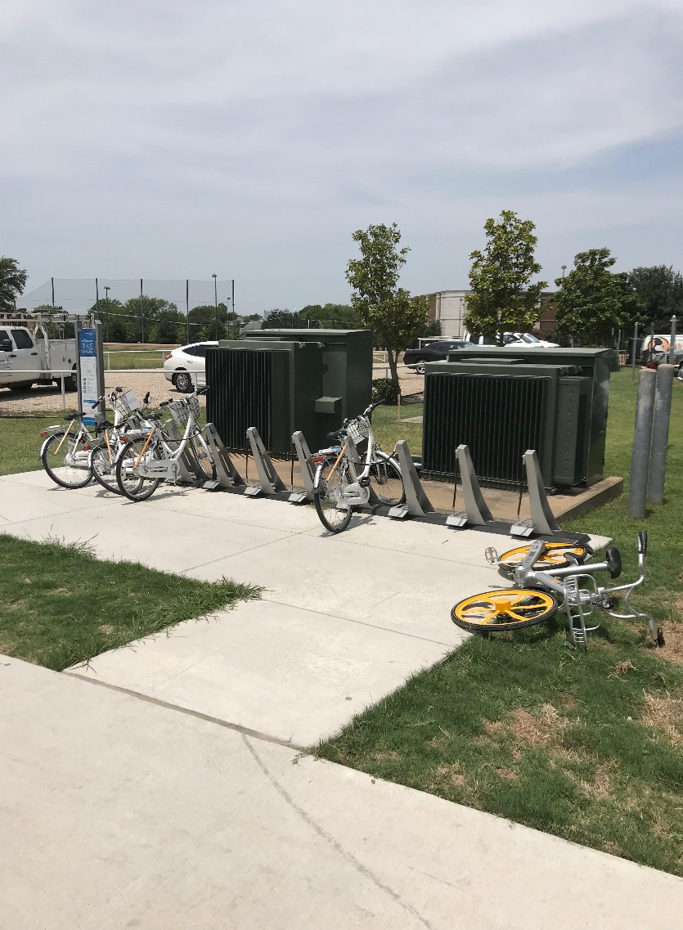
University crossing bike share

Slide 24
Glencoe park – Mural
The University Crossing Public Improvement District (UCPID) is proud to fund mural in Glencoe Park
Scope of the Project & Our Partners:
The mural will be painted along the retaining wall that forms the western boundary of Glencoe Park
UCPID will fully fund this project, but we have worked closely with the City of Dallas, Park & Recreation Dept. (Park & Rec.) as well as TXDOT
Mural Selection & Cost:
The UCPID sent a Request for Art Concepts to several artists in Dallas. Three (3) artists responded with formal concepts
The UCPID’s Art Committee reviewed the Art Concepts and made a recommendation to the full Board of Directors for approval
Approximate Cost: $45,000
Next Steps: The UCPID will work with the winning artist, and we hope the mural will be complete by August 2019

Slide 25
University crossing trail (UCT)- Way-finder signs
The University Crossing Public Improvement District (UCPID) is installing seven (7) Way-Finder Signs along the UCT – They will identify key streets and locations along the UCT
The signs will be installed at the following locations:
Glencoe Park
The Highland Hotel & Residences
Mockingbird Station
The Crossing Apartment & Business Complex
SMU – Robson & Lindley Aquatics Center
University Park – Municipal Center
Skillman Blvd.
Next Steps: Enjoy the signs!!!

Slide 26
University crossing trail (Way-Finder Sign Design)

Slide 27
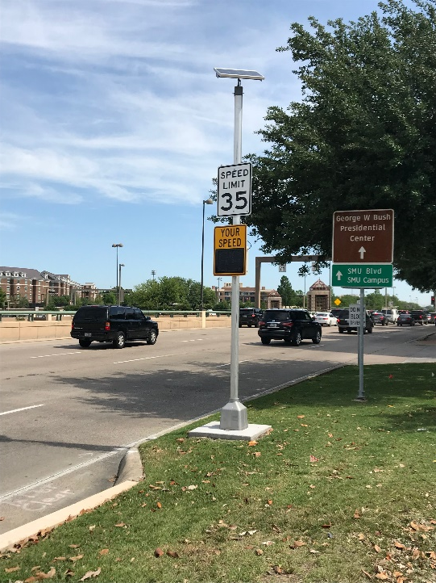
Radar feedback sign
Background: In 2018 the UCPID installed a Radar Feedback sign near the Highland Residences
As part of the UCPID’s ongoing commitment to pedestrian safety– A new Radar Feedback sign is scheduled to be installed along the NBFR 75 Feeder Road near Premier Place just north of Mockingbird Station
The installation of this sign will be done in partnership with the City of Dallas (City), TXDOT, CBRE, and Mockingbird Station
Cost: The UCPID, CBRE, and Mockingbird Station will split the cost of the sign & installation
Next Steps: The City will maintain the Radar Feedbacks to ensure it works properly

Slide 28
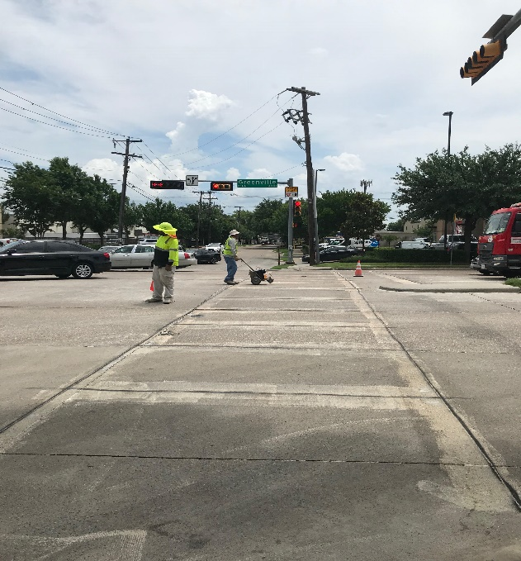
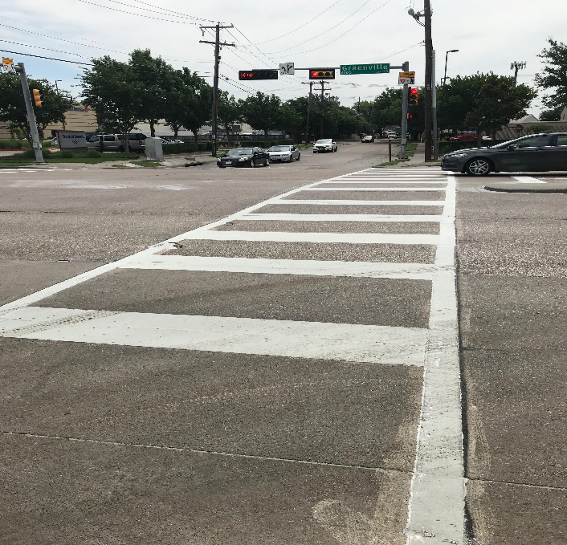
Repainting pedestrian crosswalks
To promote pedestrian safety - The UCPID will repaint three (3) Pedestrian Crosswalks in our community
The Intersections include:
Greenville Avenue & Milton
Greenville Avenue & University
Greenville Avenue & SMU Blvd.
These intersections were chosen because of the rate of high pedestrian traffic
Next Steps: The UCPID will continue to monitor crosswalks in our community to help ensure pedestrian safety!

Slide 29
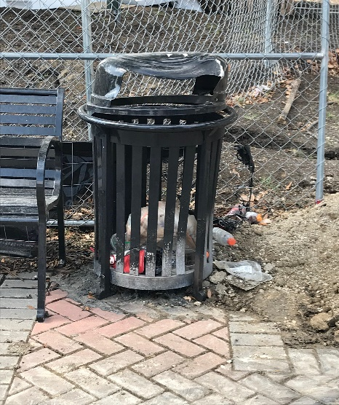
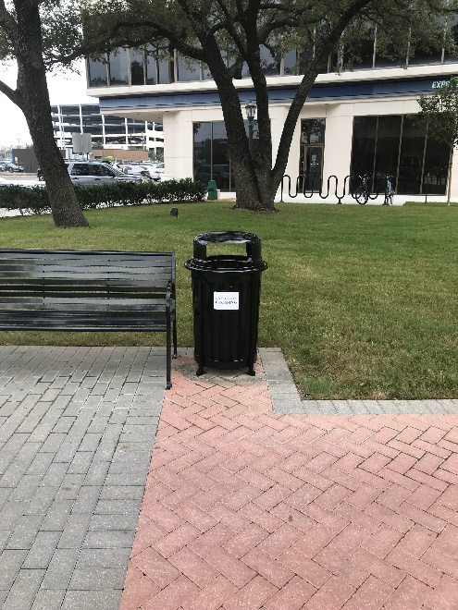
New trash receptacles (sMU Blvd.)
In 2018- Three (3) new Trash Receptacles were installed along SMU Blvd.
These trash receptacles are part of the University Crossing Public Improvement’s(UCPID) mission to keep our community clean!
Maintenance: When the UCPID’s maintenance crews work on SMU Blvd. - They also empty these trash receptacles
Next Steps: Please use these trash receptacles and encourage your friends and family to do the same! Working together – We can help keep our community clean!!!

Slide 30
Mockingbird pedestrian & bicycle study
Under the City of Dallas’ 2017 Bond Package - Improvements outlined in the Mockingbird Pedestrian & Bicycle Study are designated for funding (This would not have been possible with out the leadership of Rep. Morgan Meyer and Councilmember Philip Kingston)
In addition to the City of Dallas, TXDOT and the NCTCOG have also pledged to help fund these improvements
TXDOT has already begun implementing improvements from the Mockingbird Pedestrian & Bicycle Study (TXDOT’s improvements can be found at the intersection of Mockingbird Ln. & US75 in the form of new pedestrian crossings.)
Next Steps: The UCPID is working closely with the City of Dallas to help facilitate this project. If helpful, we will host community engagement meetings to ensure the public is informed.

Slide 31
Let’s Welcome the “split atom” sculpture
Background: For decades, the “Split Atom” sculpture was located in front of the Energy Square II Building - near the Lovers Lane DART Stop
Generous Donation: GlenStar Properties, who own and manage Energy Square & the Meadows Building, offered to donate this sculpture for use along the University Crossing Trail (Our community is very grateful for this generous donation!!!)
New Location: The Highland Hotel & Residences have generously offered to give the sculpture a new home – The new home will be next to the University Crossing Trail & just south of the pedestrian bridge over Mockingbird Lane
Next Steps for the “Split Atom” Sculpture: The UCPID has offered to fund the relocation of the sculpture and will be working with both property owners!
Next Steps for the new “Pocket Park”: The UCPID will also be installing a small “pocket park” directly across form the “Split Atom” sculpture…We want the public to be able to enjoy this exciting piece of art along the trail!

Slide 32
the “Split Atom” Sculpture! (A Landscape design - near the highland residences)

Slide 33
The new “pocket park” (across from the “split atom sculpture”)

Slide 34
2018 – 2019 Maintenance Programs

Slide 35
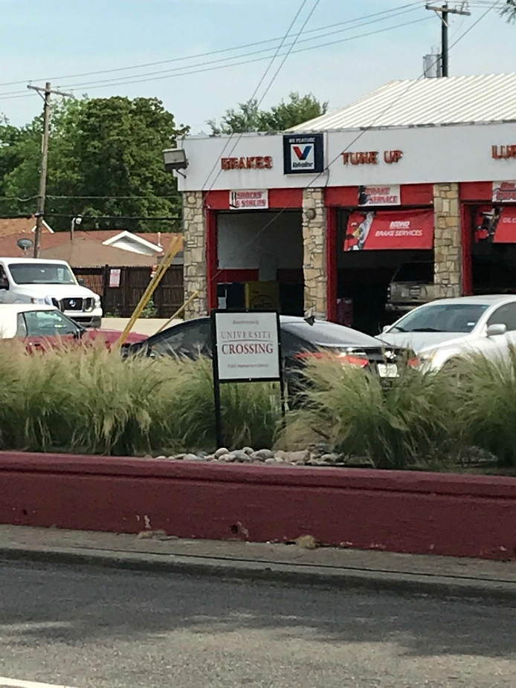
Maintenance plan (mockingbird Lane)
In 2019 - The UCPID hired Green2B to maintain Mockingbird Lane (Maintenance starts west of US75 (near the CVS) and continues east to Matilda)
Green2B strives to keep the UCPID portion of Mockingbird Lane free of trash, debris, and weeds and also trims the medians on a regular basis
Green2B also maintains portions of the US75 Access Road - Along southbound US75 near Mockingbird Lane
Repainting Planters: Beginning in 2018, the UCPID repainted the planters. In 2019, the UCPID funded a “paint touch up” to keep the planters looking good!
Next Steps: We plan to continue this Maintenance Plan but welcome any feedback or suggestions

Slide 36
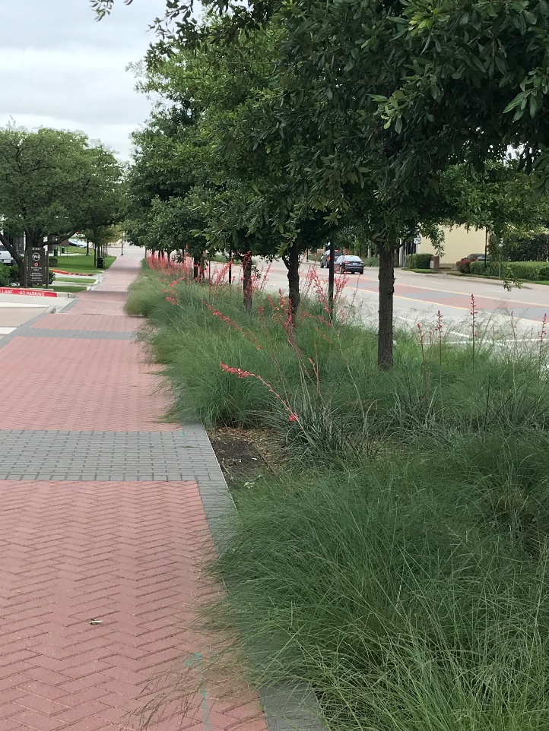
Maintenance plan (SMU Blvd.)
In 2019 - The UCPID hired Green2B to maintain portions of SMU Blvd. (Maintenance is from US75 to Greenville Avenue)
Green2B is tasked with maintaining SMU Blvd. free from trash and debris and maintain portions of the landscaping – which includes the southside of the sidewalk and the medians
Next Steps: We plan to continue this Maintenance Plan but welcome any feedback or suggestions

Slide 37
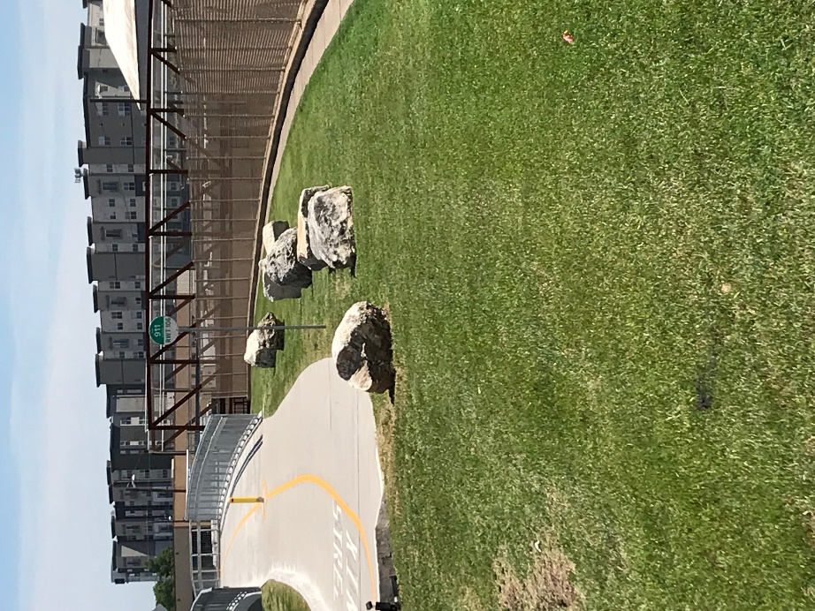
Maintenance plan (university crossing trail)
In 2019 - The UCPID hired Green2B to maintain a portion of the University Crossing Trail (UCT) (Maintenance is from SMU Blvd. to Twin Sixties Dr.)
Green2B is tasked with maintaining the UCT free from trash and debris and maintaining the landscaping – which includes Spanish Grass
Next Steps: We plan to continue this Maintenance Plan but welcome any feedback or suggestions

Slide 38
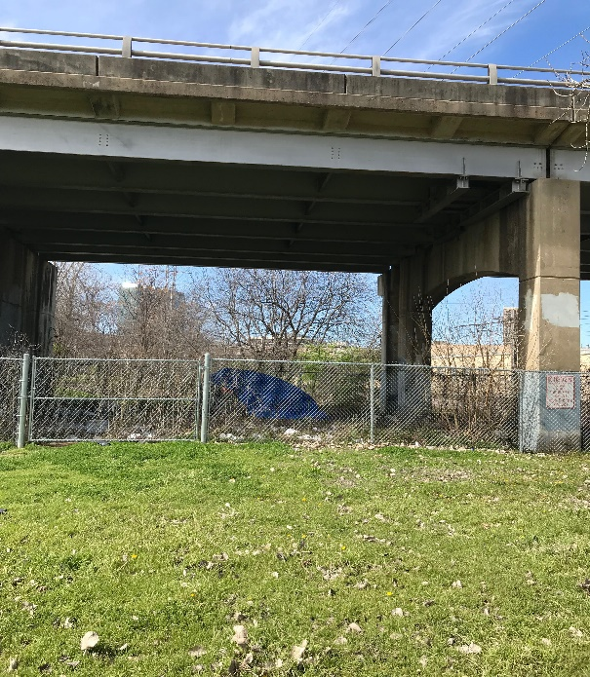
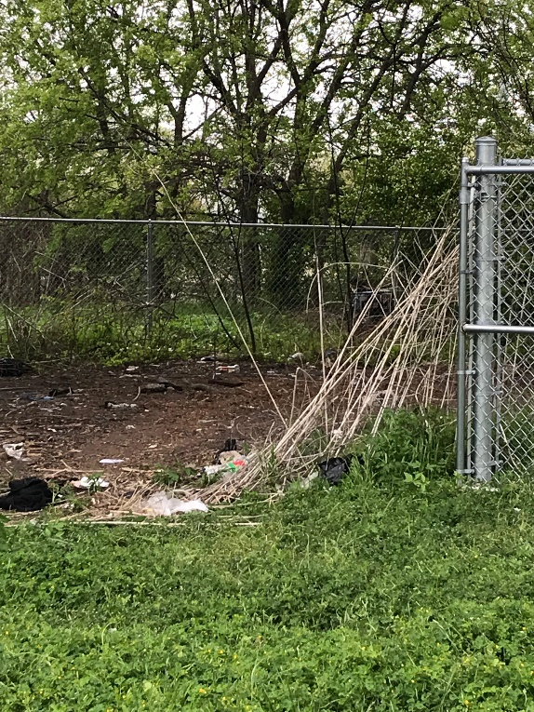
Maintenance (Through community advocacy)
In addition to funding Maintenance Programs - The UCPID also acts as an advocate for our community!
This year, the UCPID partnered with the City of Dallas to clean-up a homeless encampment on public property
Additionally – The UCPID teamed up with a private property owner to remove a homeless encampment from their property
Next Steps: Please contact the UCPID if you have concerns about a specific area or property – The UCPID is here to advocate for you!

Slide 39
Supporting st. Patrick’s day clean-up and other strategic programs
The UCPID was a key sponsor of the annual St. Patrick’s Day Parade
The UCPID also expends additional funds to ensure that areas close to the parade route are clean after the parade finishes
The St. Patrick’s Day Parade is an important event for our community every year and the UCPID was proud to participate

Slide 40
2018 – 2019 communication and cultural programs

Slide 41
Maintaining university crossing website (www.universitycrossing.com)
Throughout 2018 & 2019- The UCPID maintained its website in an effort to provide citizens with up-to-date information about our community
The UCPID encourages citizens to visit our website to find information about:
Cultural Programs
Sporting Events
New Businesses & Restaurants
Public Service Announcements
Next Steps: The UCPID welcomes suggestions to make this website as informative and engaging as possible

Slide 42
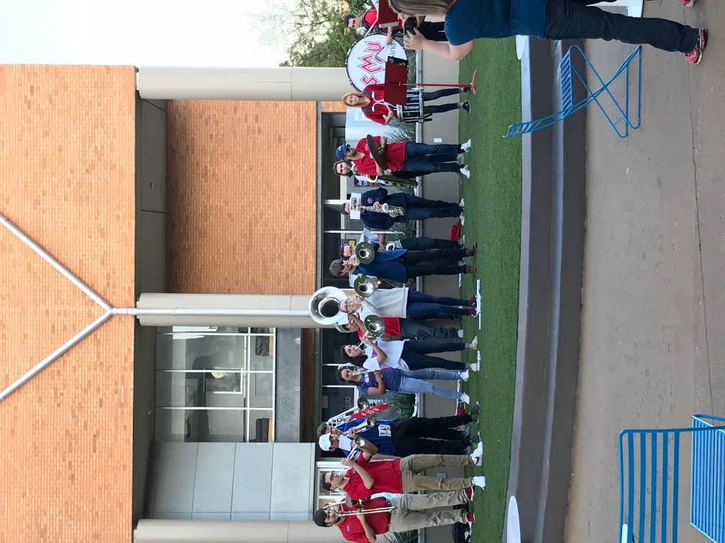
Music on mockingbird
In a continuation from last year - The Music on Mockingbird program is a collaboration between the UCPID, the SMU Meadows School, Bridge the Gap, and Mockingbird Station
This program provides live musical performances, located at Mockingbird Station near the Angelika Movie Theater
The UCPID is proud to provide a small stipend to these performers - In return our community gets to experience great musical performances!
Next Steps: Enjoy the Music!

Slide 43
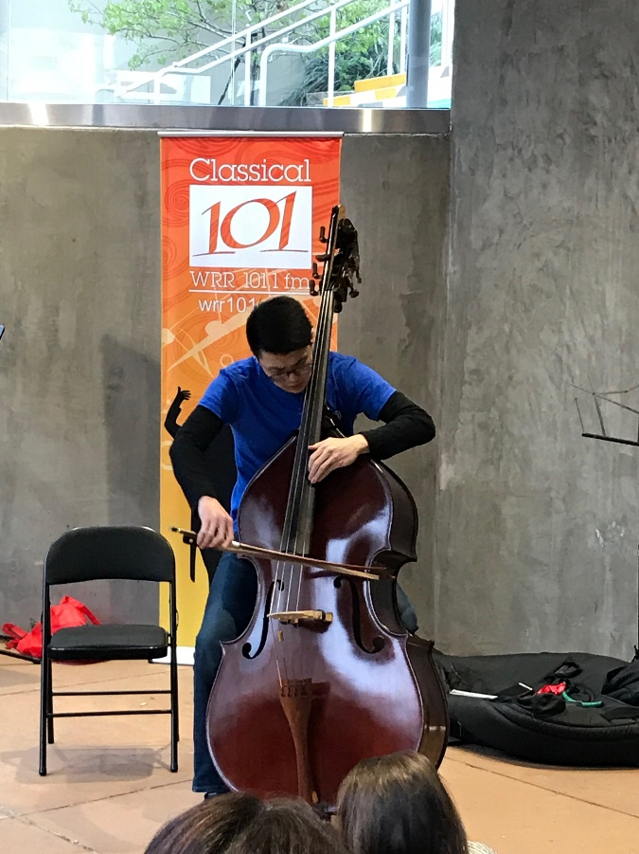
Bach in the subways
In 2019 – The second annual “Bach in the Subways” came to our community
“Bach in the Subways” is an international program that occurs every March to honor the birthday of the classical music composer Johann Sebastian Bach
To honor Bach, musicians all over the world perform his music around mass transit stops
This year, in a collaboration between the UCPID, the SMU Meadows School, Bridge the Gap, Mockingbird Station, and 101.1FM – Musicians from Bridge the Gap performed Bach at Mockingbird Station
A large crowd was treated to some great music!!!
Next Steps: We hope to host a similar performance in 2020!

Slide 44
University Crossing Resource Guide
In 2018 & 2019 - The UCPID continued to utilize its Resource Guide
The Resource Guide is FREE to the public and it was created to provide helpful information for our community
The Resource Guide includes such information as:
When to Call 911
Pedestrian & Bicycle Safety Tips
How to obtain a Criminal Trespass Affidavit (CTA)
Contact information for City Services - Including Police, Fire, Code Compliance, etc.
Next Steps: We plan to update the Resource Guide and welcome your feedback and suggestions

Slide 45
UNIVERSITY CROSSING CULTURE-LED REGENERATION PROJECT
In 2019 – The University Crossing Public Improvement District (UCPID), SMU, and the City of Dallas, Office of Cultural Affairs (Cultural Affairs) began developing a program to transform the University Crossing Trail (UCT) into an Art Corridor!
Each Partner brings something unique to this project:
The UCPID will provide community contacts and possible funding for Temporary & Long-Term Art Projects
SMU will analyze public art programs from around the world and provide recommendations to our community
SMU will also develop a Community Survey (Using the Survey - SMU will provide suggestions for Temporary & Long-Term Art)
Cultural Affairs will provide guidance and logistical support
Next Steps: Through this partnership– In 2019 & 2020 we hope to create an Art Corridor that will enrich the lives of our community!

Slide 46
2019 service plan

Slide 47
 |  | 2019 Budget | 2020 Budget | 2021 Budget | 2022 Budget | 2023 Budget
INCOME
 | Fund balance from previous year⁸ | 1,412,000 | 547,000 | 304,000 | 1,500 | 0
 | Net assessment revenue | 871,000 | 888,000 | 906,000 | 924,000 | 942,000
 | Reimbursement from NTCOG | 0 | 640,000 | 0 | 0 | 0
 | Exempt jurisdictions | 0 | 0 | 0 | 0 | 0
 | Interest on cash balances | 2,000 | 3,000 | 1,500 | 1,500 | 1,500
 | Other income & contributions | 0 | 0 | 0 | 0 | 0
 | TOTAL INCOME¹ | $2,285,000 | $2,078,000 | $1,211,500 | $927,000 | $943,500
EXPENDITURES
 | Security² | 227,000 | 232,000 | 237,000 | 237,000 | 237,000
 | Improvements³ | 1,120,000 | 1,142,000 | 564,000 | 281,000 | 297,500
 | Public Area Maintenance⁴ | 156,000 | 159,000 | 162,000 | 162,000 | 162,000
 | Promotion and Communication⁵ | 77,000 | 79,000 | 81,000 | 81,000 | 81,000
 | Organization & Administration⁶ | 128,000 | 131,000 | 134,000 | 134,000 | 134,000
 | Audit & Insurance⁷ | 30,000 | 31,000 | 32,000 | 32,000 | 32,000
 | TOTAL EXPENDITURES | $1,738,000 | $1,774,000 | $1,210,000 | $927,000 | $943,500
FUND BALANCE/RESERVES |  | $547,000 | $304,000 | $1,500 | $0 | $0

Slide 48
University crossing public improvement district – renewal application
In 2020 – The University Crossing Public Improvement District (UCPID) will submit a formal application to the City of Dallas to Renew our Agreement and continue our work!!!
Background: In 2013- The UCPID was formed by the property owners to enhance the quality of life, of the citizens its serves, by providing supplemental services that otherwise would not exist (These services have been enumerated in this presentation)
What is Renewal? Every seven (7) years Public Improvements Districts (PID) around the City, like the UCPID, are required to petition their property owners in order to continue operating
What happens in 2019 & 2020? The UCPID will formally repetition the property owners in the PID. If at least 60% of the property owners, representing the total value of the PID, and more than 60% of the number of property owners of record or 60% of the land area, vote to approve the repetition…The UCPID can continue to operate for another seven (7) years!!!
Next Steps: The UCPID will work with the City to develop a formal petition, and then…We ask for your continued support, so the UCPID can continue to serve our community!!!

Slide 49
Goals for 2019-2020
Obtain Renewal!
Support Public Safety: Utilizing our ENP Program - with an emphasis on community engagement and proactive policing – The UCPID will enhance the safety of our community!
Support Capital Improvements: With an emphasis on Pedestrian Safety – Complete projects like: Pedestrian Lighting along the University Crossing Trail (UCT) & Installation of Way-Finder signs along the UCT
Support Maintenance Programs: Enhance the quality of life of our community through vigilant maintenance
Promote our Community: Highlight local businesses on the web and through social media
Promote the Arts: To strengthen community identity and engagement by continuing to support Music on Mockingbird, complete the mural in Glencoe Park, and transform the UCT into an Art Corridor

Slide 50
Thank you for coming! Please Visit us AT: www.universitycrossing.com Like us AT:

